Slide 1
PDF

Slide 2
PDF Extensions
Adobe’s Portable Document Format (PDF) provides a popular way to get a consistent look, both on screen and when printed, for documents.
PHP has several libraries for generating PDF documents.
The FPDF library is a set of PHP code you include in your scripts with the require function, so it doesn’t require any server-side configuration or support, meaning you can use it even without support from your host.
http://www.fpdf.org/en/download.php can be used to download the fpdf library (v 1.81, ZIP)

Slide 3
FPDF LIBRARY
FPDF is a PHP class which allows to generate PDF files with pure PHP, that is to say without using the PDFlib library.
F from FPDF stands for Free: you may use it for any kind of usage and modify it to suit your needs.
FPDF has other advantages: high level functions. Here is a list :-
Choice of measure unit, page format and margins
Page header and footer management
Automatic page break
Automatic line break and text justification
Image support (JPEG, PNG and GIF)
Colors
Links
TrueType, Type1 and encoding support
Page compression

Slide 4
DOCUMENTS AND PAGES
A PDF document is made up of a number of pages.
Each page contains text and/or images.
<?php
require("../fpdf/fpdf.php"); // path to fpdf.php
//reference to the FPDF library with the require function
$pdf = new FPDF();
//created a new instance of the FPDF object.
$pdf->addPage();
//After you have created the new instance of the FPDF object, you will need to add at least one page to the object, so the AddPage method is called.
$pdf->setFont("Arial", 'B', 16);
//you need to set the font for the output you are about to generate with the SetFont call
$pdf->cell(40, 10, "Hello Out There!");
//using the cell method call, you can place the output on your created document.
$pdf->output();
//To send all your work to the browser, simply use the Output method.
?>

Slide 5
Cell(float w , float h , string txt , mixed border , int ln , string align , boolean fill , mixed link)
W = Cell width. If 0, the cell extends up to the right margin. .
H = Cell height. Default value: 0.
Txt = String to print. Default value empty
Border = (1,0), (L,T,R,B)
In = 0 to the right, 1 beginning of next line, 2 below
Align = L,R,C
Fill = cell background to be painted true or false
Mixed = url returned by addlink()

Slide 6
Text
There are many options for changing the appearance and layout of text.
Coordinates
The origin (0,0) in a PDF document with the FPDF library is in the top-left corner of the defined page.
All of the measurements are specified in points, millimeters, inches, or centimeters. A point (the default) is equal to 1/72 of an inch, or 0.35 mm
Text attributes
There are three common ways to alter the appearance of text: bold, underline, and italics.
Setfont(string family , string style , float size);
Family = Courier (fixed width), Helvetica or Arial (Sans Serif), Times (Serif), Symbol (Symbolic), Zapfdingbats (Symbolic)
Style = empty, B, I, U
Size = font size in point.

Slide 7
Addfont(string family , string style , string file)
Family = font family name.
Style = empty, B, I, U
File = The font definition file.
Settextcolor(int r , int g, int b)
r = red component (0 – 255)
g = green component (0 – 255)
b = blue component (0 – 255)

Slide 8
IMAGE AND LINKS
The FPDF library can also handle image insertion and control links within the PDF document or externally to outside web addresses.
We have to specify an image file to use and to call the image() method to place the image on the PDF document.
image(file , float x , float y , float w , float h , string type , mixed link)
File = Path or URL of the image.
Float x = coordinate of the upper-left corner.
Float y= coordinate of the upper-left corner.
Float w= Width of the image in the page.
Float h= Height of the image in the page.
Type= Image format JPG, JPEG, PNG and GIF.
Link = URL or identifier returned by AddLink().

Slide 9
FPDF can create two kinds of links.
One kind is to have a link within the PDF document to another location within the same document (two pages later, or wherever you set the anchor for the link); this is called an internal link.
The other kind is an external web URL link.
An internal link is created in two parts. First you define the starting point or origin for the link, and then you set the anchor, or destination, for where the link will take you when it is clicked.
To set a link’s origin, use the addLink() method. Return a handle that you need to use when creating the destination portion of the link.
We create the destination portion of the link with the setLink() method, which takes the origin’s link handle as its parameter, so that it can perform the join between the two steps.

Slide 10
External URL type link, can be done in two ways.
If you are using an image as a link, you will need to use the image() method.
If you want straight text to be used as a link, you need to use the cell() or write() method.

Slide 11
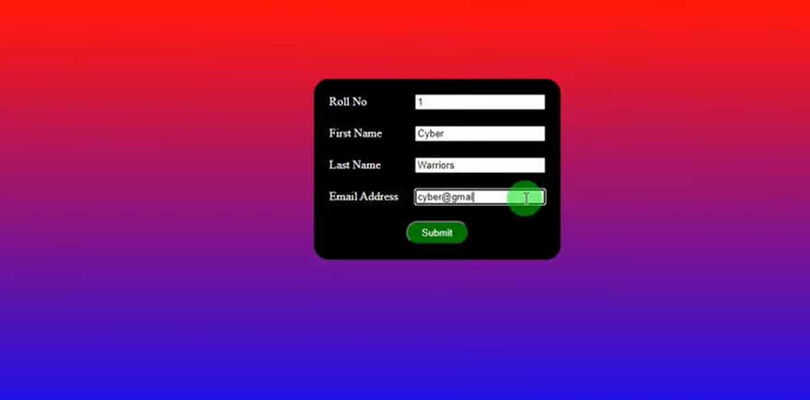
creating pdf documents in php

Slide 12
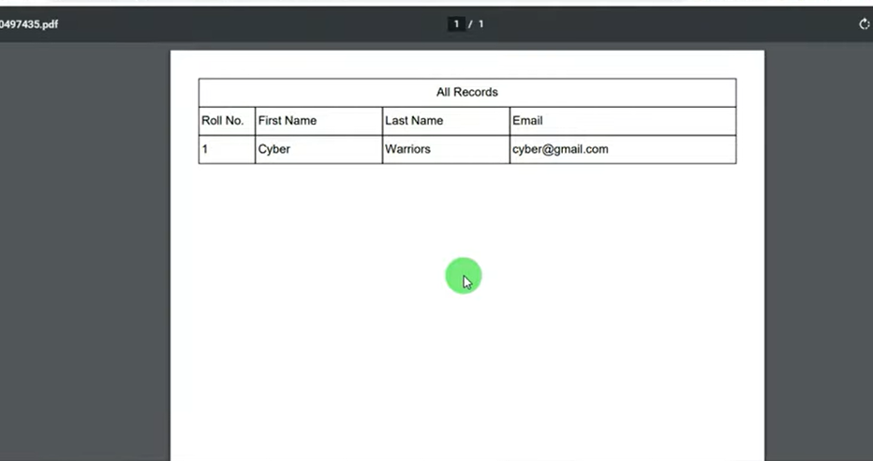
creating pdf documents in php

Slide 13
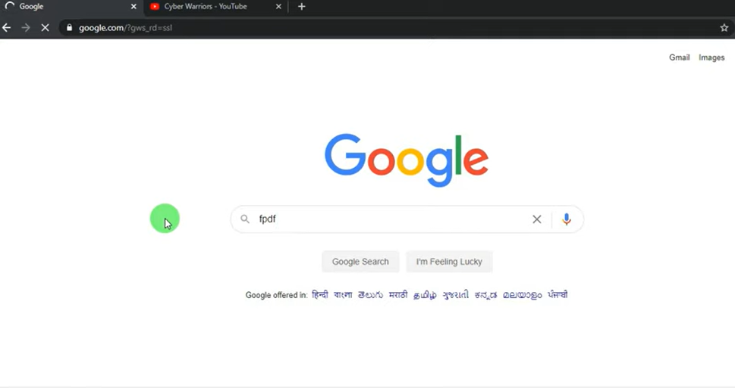
creating pdf documents in php

Slide 14
<?php
if(!empty($_POST['submit']))
{
$roll= $_POST['rollno'];
$F_name= $_POST['firstname];
$l_name= $_POST['lastname'];$
$email= $_POST['email'];
require("fpdf.php");
$pdf = new FPDF();
$pdf->Addpage();
$pdf=SetFont("arial","",16);
$pdf->Cell(0,10,"Registartion Details",1,1,'C');
$pdf->Cell(20,10,"Roll No.",1,0);
$pdf->Cell(45,10,"first Name",1,0);
$pdf->Cell(45,10,"Last name",1,0);
$pdf->Cell(0,10,"Email",1,0);
$pdf->Cell(20,10,$roll,1,0);
$pdf->Cell(45,10,$fname,1,0);
$pdf->Cell(45,10,$lname,1,0);
$pdf->Cell(0,10,$email,1,0);
$pdf->output();
?>

